Slide 1
MACHINE LEARNING AND NEURAL NETWORKS

Slide 2
About The Instructor
from Budapest, Hungary
BSc in physics
MSc in applied mathematics
working as a software engineer
special addiction to algorithms, artificial intelligence and
quantitative finance

Slide 3
About The Course
Machine Learning
linear regression, logistic regression, SVM, clustering algorithms ...
Neural Networks
Feedforward-neural networks, backpropagation, gradient descent ...
Deep Learning
deep networks, convolutional neural networks, recurrent neural networks ...
Reinforcement Learning
Markov Decision Processes, value- and policy iteration, Q-learning

Slide 4
HD Option For the Lectures

Slide 5
Types of Learning
There are three main tyes of learning in artificial intellience
and machine learning:
1.) supervised learning
2.) unsupervised learning
3.) reinforcement learning

Slide 6
Types of Learning
SUPERVISED LEARNING
We have a dataset: with samples and labels as well
~ most of the machine learning techniques rely heavily on datasets
WE GIVE THE ALGORITHM THE RIGHT ANSWERS !!!
x
y
x XOR y
During the training procedure:
→ the input is the features (x,y)
→ the output is the x XOR y label
The aim is to make sure the prediction of the
neural network is approximately the same
as the label in the dataset
0
0
0
0
1
1
1
0
1
1
1
0

Slide 7
Types of Learning
SUPERVISED LEARNING
We have a dataset: with samples and labels as well
~ most of the machine learning techniques rely heavily on datasets
WE GIVE THE ALGORITHM THE RIGHT ANSWERS !!!
During the training procedure:
→ the algorithm will find out what is the
difference between the two classes
x
2
x
1

Slide 8
Types of Learning
SUPERVISED LEARNING
We have a dataset: with samples and labels as well
~ most of the machine learning techniques rely heavily on datasets
WE GIVE THE ALGORITHM THE RIGHT ANSWERS !!!
During the training procedure:
→ the algorithm will find out what is the
difference between the two classes
x
2
x
1

Slide 9
Types of Learning
UNSUPERVISED LEARNING
We have a dataset: samples without labels
~ the algorithm will find some patterns in this unlabeled dataset
For example: clustering algorithms
During the training procedure:
→ the algorithm will find some relevant
features to make the classification
x
2
x
1

Slide 10
Types of Learning
UNSUPERVISED LEARNING
We have a dataset: samples without labels
~ the algorithm will find some patterns in this unlabeled dataset
For example: clustering algorithms
During the training procedure:
→ the algorithm will find some relevant
features to make the classification
x
2
x
1

Slide 11
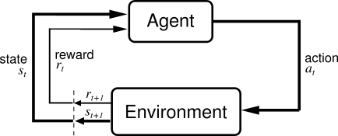
Types of Learning
REINFORCEMENT LEARNING
We do not have a dataset at all !!!
~ the artificial intelligence agent will interacts with the
environment (states) and figurest out what to do (actions)
UPON DOING ACTIONS THE AGENT RECEIVES A REWARD/PENALTY !!!
finding the shortest path: there are states (cells) and
actions (we can visit the neighbor cells)

Slide 12
Types of Learning
REINFORCEMENT LEARNING
0
X
reinforced learning can be used to learn
playing tic-tac-toe game
environment: cells on the board
the agent (computer player) makes a move
according to the board states
move: where to put the X
eventually the game will end: agent will receive
reward (win) or receive penalty (lose)
0
X
The computer (agent) initially plays poorly: but after the training procedure (so playing a lot)
it will be able to choose the right actions/moves !!!

Slide 13
Linear Regression
It is an approach for modelling the relationship between scalar dependent
variable y and one or more explanatory variables x
SIMPLE LINEAR REGRESSION MULTIPLE LINEAR REGRESSION
single explanatory variable x
we want to approximate the price
of houses if we know the sizes
several explanatory variables x
we want to approximate the price
of houses if we know the sizes,
number of rooms...
We use linear predictor functions: this is why it is called LINEAR regression

Slide 14
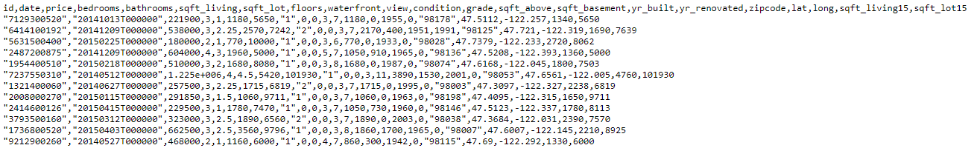
Linear Regression
Linear regression is the first machine learning algorithms: as usual it needs a dataset
Dataset: house_sales.csv
Contains information about a home sold between May 2014 and May 2015 along
with the price ~ multiple explanatory variables are present

Slide 15
Linear Regression
prices [$]
What is the aim of Linear Regression?
→ want to find some linear relationship
between the features
500
400
independent variable we use to
make predictions (size of house)
300
H(x) = b + b x
0
1
200
dependent variable, this is what we
are trying to predict or estimate
(price of the house)
100
2
size of houses [m ]
30
50
80
100

Slide 16
Linear Regression
prices [$]
So we build a model based on the dataset
It is a linear model: so the result is a linear line
→ the model defines the relationship
between the variables
→ we can make predictions with the
trained model
What does it mean? If we have a new x feature
(size of the house) we can get the H(x) price
of the house accordingly
500
400
300
200
100
2
size of houses [m ]
30
50
80
100

Slide 17
Linear Regression
we have a dataset (all machine learning algorithm needs one)
we train the algorithm: which means finding the linear relationship
between the H(x) and x variables
H(x) = b + b x
OPTIMIZATION !!!
0
1
after the training we have the b values which means
we can make predictions with the model
(for new datapoints)

Slide 18
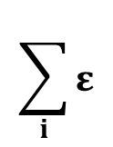
Linear Regression
ε
Mean Squared Error (MSE)
7
It is the difference between the y actual values present in the
dataset (supervised learning) and the H(x) values
predicted by the model
ε
ε
8
4
ε
ε
5
6
ε
ε
2
1
3
[ H(x) – y ]
„cost-function”
ε
2
if this term is small (small error): it means the model
predictions are very close to the actual values GOOD
$$\sum_{i}{ε}$$
if this term is big (huge error): it means the model
predictions differ from the actual values BAD
MSE =
2
i

Slide 19
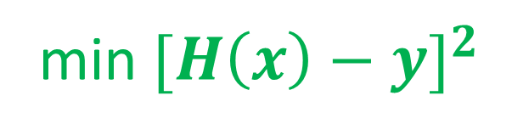
Linear Regression
OPTIMIZATION PROBLEM
This is why optimization algorithms are so important
~ no matter what problem we are dealing with, finally we have to use
some optimization methods to solve it
this is the prediction from
our linear model (linear regression)
min ${[H\left(x\right)−y]}^{2}$
b
we want to find the minimum by
tuning these parameters
this is the value we know from
the training data
// supervised learning !!!

Slide 20
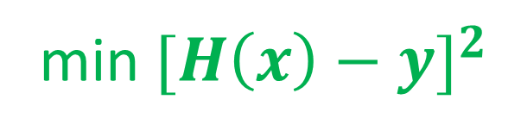
Linear Regression
OPTIMIZATION PROBLEM
This is why optimization algorithms are so important
~ no matter what problem we are dealing with, finally we have to use
some optimization methods to solve it
Design Matrix Approach (linear algebra)
we can transform the problem into linear equations and
use the standard method (using matrix operations)
min ${[H\left(x\right)−y]}^{2}$
-1
b
b = (X’X) X’ y
https://onlinecourses.science.psu.edu/stat501/node/382
Gradient Descent
→ it is a first-order iterative optimization algorithm
for finding the minimum of a function

Slide 21
Linear Regression
OPTIMIZATION PROBLEM
This is why optimization algorithms are so important
~ no matter what problem we are dealing with, finally we have to use
some optimization methods to solve it
Design Matrix Approach (linear algebra)
Gradient Descent
for low-dimensional problems
it is the best approach
iterative approach
works fine in higher dimensions
and usually this is the case
low-dimension means few features
if the matrix is huge: matrix operations
are expensive in higher dimensions
Matrix inversion: O(N )
USUALLY THIS IS THE CASE !!!
3

Slide 22
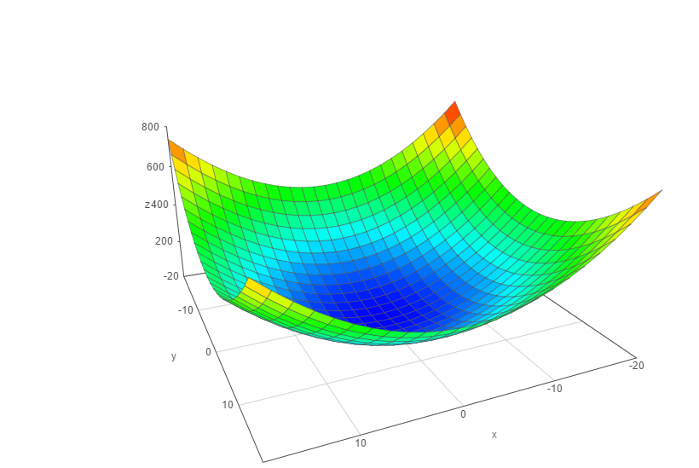




Gradient Descent
We have to know the partial derivative of the C(b) cost function
and go to the direction of the gradient
// gradient ~ partial derivative
C(b)
$$\frac{∂C(b)}{∂b}$$
$$\frac{∂C(b)}{∂b}$$
0
1
the f(x) gradient of a given f(x) function
is pointing in the direction of maximum
Δ
we are after the minimum: so we have to use
- f(x) instead
Δ
b
1
make iterations {
}
b
$$\frac{∂C(b)}{∂b}$$
$$\frac{∂C(b)}{∂b}$$
0
b ← b – α
b ← b – α
0
0
1
1
0
1

Slide 23
Gradient Descent
C(b)
α: learning-rate
→ small learning-rate: the algorithm takes small
steps towards the minimum
~ takes more time to converge
→ huge learning-rate: the algorithm takes big
steps towards the minimum
~ algorithm is faster but not
as accurate
b
1
b
0

Slide 24
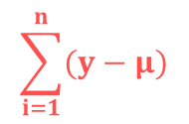

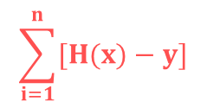

Linear Regression - Parameters
2
The R statistic is defined as follows:
2
$$\frac{RSS}{TSS}$$
// the higher the better the model fits the data
R = 1 -
measures the accuracy of the regression models
It is the square of the correlation coefficient r
~ so it measures how strong of a linear relationship is
between two variables !!!
RSS - „residual sum of squares”
Measures the variability left unexplained after performing the regression
TSS - „total sum of squares”
It measure the total variance in y
$$\sum_{i=1}^{n}{[H(x)−y]}$$
2
$$\frac{1}{n}$$
$$\sum_{i=1}^{n}{(y−μ)}$$
2

Slide 25
Logistic Regression
Linear Regression solves regression problem: the prediction is a value
For example: we have the features (size of flat, number of rooms...) and this model
is able to predict the price
Logistic Regression solves classification problems
Usually we use this method for binary classification
For example: spam detection for emails, predicting if a customer will
default on a loan ...
OUTCOME OF DEPENDENT VARIABLE IS DISCRETE !!!
it assigns probabilities to given outcomes
So the output is a probability that the given input belongs to
a certain class

Slide 26
Logistic Regression
Applying Linear Regression for classification problem is
not a good idea
→ it has values outside the [0,1] range
→ it is sensitive to outliers
→ we want to deal with probabilities as well
paying back
the debt
1 (YES)
0 (NO)
balance on
credit card
300
500
800
1000

Slide 27
Logistic Regression
Applying Linear Regression for classification problem is
not a good idea
→ it has values outside the [0,1] range
→ it is sensitive to outliers
→ we want to deal with probabilities as well
paying back
the debt
1 (YES)
0 (NO)
balance on
credit card
300
500
800
1000

Slide 28
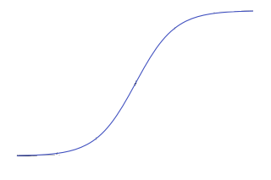
Logistic Regression
Applying Linear Regression for classification problem is
not a good idea
→ it has values outside the [0,1] range
→ it is sensible to outliers
→ we want to deal with probabilities as well
paying back
the debt
1 (YES)
0 (NO)
balance on
credit card
300
500
800
1000

Slide 29
Logistic Regression
We have to deal with the sigmoid-function
1
f(x) =
1 + e
-x
we are able to solve the problems we have discussed
it has a value between [0,1]
it can be interpreted as probability

Slide 30
Logistic Regression
We have to deal with the sigmoid-function
the probability of default given x balance
p(x) = P(y=1|x=balance)
1
p(x) =
1 + e
- (b + b * x)
0
1
these are the model parameters b and b
0
1
There are several ways to fit the model
→ gradient descent
→ maximum-likelihood method

Slide 31
Logistic Regression
We have to deal with the sigmoid-function
p(x)
ln ( ) = b + b x
„logit transformation”
1 - p(x)
0
1
the point of the logit transformation is to make it linear: so logistic regression
is a linear regression on the logit transformation
how to fit the b parameters: with gradient descent and maximum-likelihood method
It is a generalized linear model: not because the estimated probability of the response is linear but
because the logit of the estimated probability response is a linear function of the parameters

Slide 32
Logistic Regression
SIMPLE LOGISTIC REGRESSION MULTINOMIAL LOGISTIC REGRESSION
we have just a single x parameter
For example: balance on credit card
we have multiple x parameters
For example: balance on credit card, age,
gender, demographics, loan to income ratio ...
1
1
p(x) =
p(x) =
1 + e
- (b + b * x)
1 + e
- (b + b * x + ... + b x )
0
1
0
1
1
n
n
Usually we use logistic regression for binary classification: so with 2 output classes
For example: email is spam or not, client is sick or healthy ...

Slide 33
Logistic Regression – Maximum Likelihood
Maximum Likelihood Estimation is a method of estimating the parameters of a statistical model
given observations, by finding the parameter values that maximize the likelihood of
making the observations given the parameters
→ the method is based on a likelihood-function
log likelihood-function
l(β,x) = ln L(β,x)
likelihood-function
The aim is the same as we have seen for Linear Regression: we are after the
optimal β values that maximize the likelihood-function
β such that { arg max l(β,x)}
β

Slide 34
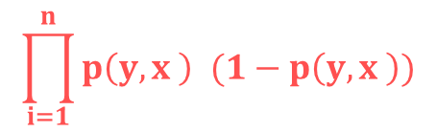
Logistic Regression – Maximum Likelihood
Maximum Likelihood Estimation is a method of estimating the parameters of a statistical model
given observations, by finding the parameter values that maximize the likelihood of
making the observations given the parameters
$$\prod_{i=1}^{n}{p\left(y,x \right) (1−p\left(y,x \right))}$$
1-y
L(β) =
y
i
i
likelihood-function for
logistic regression
i
i
i
i
1
p(y ,x ) =
i
i
1 + e
- (x’ * β )
i
this estimate is usually obtained by using the
iterative algorithm Newton-Raphson method

Slide 35
Confusion Matrix
PREDICTED
0
1
122
12
0
ACTUAL
34
89
1
Describes the performance of a classification model
→ diagonal elements: the correct classifications
→ off-diagonals: incorrect predictions

Slide 36
Cross Validation
TRAINING DATASET
TEST DATASET
~ 70% of the original dataset
~ 30% of the original dataset
We fit the model to the training dataset: then we test the model on the test dataset
~ we only have information how the model performs to our in-sample data
but we would like to see the accuracy when dealing with new data
OVERFITTING: model has trained „too well” on the training dataset
→ it means it is very accurate on the training dataset but yields
poor results on the test set (due to too complex models)
→ the model learns the „noise” instead of the actual relationships
between the variables in the data
(of course this noise is not present in the test set...)
x
2
x
1

Slide 37
Cross Validation
TRAINING DATASET
TEST DATASET
~ 70% of the original dataset
~ 30% of the original dataset
We fit the model to the training dataset: then we test the model on the test dataset
~ we only have information how the model preforms to our in-sample data
but we would like to see the accuracy when dealing with new data
UNDERFITTING: model has not been fitted well to the training dataset
→ misses the trends in the training dataset
→ this is usually the case when we use too
simple models for the problem
x
2
x
1

Slide 38
Cross Validation
K-Folds Cross Validation
helps to avoid underfitting as well as overfitting
(help to avoid overfitting more than underfitting)
the aim is to be able to generalize the model to new datasets with same accuracy
we use all the data for training !!!
TRAINING DATASET

Slide 39
Cross Validation
K-Folds Cross Validation
helps to avoid underfitting as well as overfitting
(help to avoid overfitting more than underfitting)
the aim is to be able to generalize the model to new datasets with same accuracy
we use all the data for training !!!
Let’s split the data into k folds (for example k=5)

Slide 40
Cross Validation
K-Folds Cross Validation
helps to avoid underfitting as well as overfitting
(help to avoid overfitting more than underfitting)
the aim is to be able to generalize the model to new datasets with same accuracy
we use all the data for training !!!
Let’s split the data into k folds (for example k=5)
we run k separate learning experiments
k-1 folds for training and 1 fold for the test set
we average the results from this k experiments

Slide 41
Cross Validation
K-Folds Cross Validation
helps to avoid underfitting as well as overfitting
(help to avoid overfitting more than underfitting)
the aim is to be able to generalize the model to new datasets with same accuracy
we use all the data for training !!!
Let’s split the data into k folds (for example k=5)
we run k separate learning experiments
k-1 folds for training and 1 fold for the test set
we average the results from this k experiments

Slide 42
Cross Validation
K-Folds Cross Validation
helps to avoid underfitting as well as overfitting
(help to avoid overfitting more than underfitting)
the aim is to be able to generalize the model to new datasets with same accuracy
we use all the data for training !!!
Let’s split the data into k folds (for example k=5)
we run k separate learning experiments
k-1 folds for training and 1 fold for the test set
we average the results from this k experiments

Slide 43
Cross Validation
K-Folds Cross Validation
helps to avoid underfitting as well as overfitting
(help to avoid overfitting more than underfitting)
the aim is to be able to generalize the model to new datasets with same accuracy
we use all the data for training !!!
Let’s split the data into k folds (for example k=5)
we run k separate learning experiments
k-1 folds for training and 1 fold for the test set
we average the results from this k experiments

Slide 44
Cross Validation
K-Folds Cross Validation
helps to avoid underfitting as well as overfitting
(help to avoid overfitting more than underfitting)
the aim is to be able to generalize the model to new datasets with same accuracy
we use all the data for training !!!
Let’s split the data into k folds (for example k=5)
we run k separate learning experiments
k-1 folds for training and 1 fold for the test set
we average the results from this k experiments
ADVANTAGE: all observations are used for both training and validation
+ each observations are used for validation exactly once

Slide 45
K-Nearest Neighbor Classifier
K-Nearest Neighbors (kNN) classifiers can classify examples by assigning them the class of the most similar labeled examples
very simple BUT extremely powerful algorithm !!!
kNN is well suited for classification tasks where the relationship between the features are very complex and hard to understand
we have a training dataset → examples that are classified into several categories
we have a new example (with the same number of features as the training data) → kNN algorithm identifies k elements in the training dataset that are the „nearest” in similarity
the unlabeled test example is assigned to the class of the majority of the k nearest neighbors

Slide 46
K-Nearest Neighbor Classifier
ingredients
sweetness
crunchiness
type
apple 10 9 fruit
bacon 1 4 protein
banana 10 1 fruit
carrot 7 10 vegetable
cheese 1 1 protein

Slide 47
K-Nearest Neighbor Classifier
ingredients
sweetness
crunchiness
type
apple 10 9 fruit
bacon 1 4 protein
banana 10 1 fruit
carrot 7 10 vegetable
cheese 1 1 protein
tomato 6 4 ???

Slide 48
K-Nearest Neighbor Classifier
crunchiness
carrot
cucumber
apple
bacon
orange
fish
banana
cheese
sweetness

Slide 49
K-Nearest Neighbor Classifier
crunchiness
carrot
cucumber
apple
bacon
orange
fish
banana
cheese
sweetness

Slide 50
K-Nearest Neighbor Classifier
crunchiness
We need a distance-function to be able
to classify new data (tomato) !!!
~ for example Euclidean-distance
carrot
cucumber
apple
tomato
bacon
orange
fish
banana
cheese
sweetness

Slide 51
K-Nearest Neighbor Classifier
lazy learners does not learn anything !!!
we just store the training data: training is very fast (because there is no training at all) BUT making the prediction is rather slow (calculating the distances)
WE DO NOT BUILD A MODEL !!!
this is a non-parametric learning: no parameters are to be learned about the data
Linear Regression / Logistic Regression: have to learn the β parameters either
with gradient descent or with maximum likelihood method

Slide 52
K-Nearest Neighbor Classifier
dist(x,y) =
$\sqrt{{ {(x−y )}^{2}+(x−y )}^{2}+…{+(x−y )}^{\begin{aligned}2 \\ \end{aligned}}}$
1
1
2
2
n
n

Slide 53
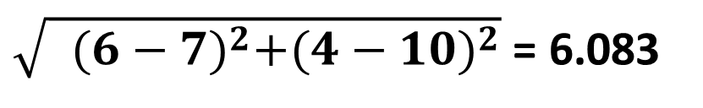
K-Nearest Neighbor Classifier
ingredients
sweetness
crunchiness
type
apple 10 9 fruit
bacon 1 4 protein
banana 10 1 fruit
carrot 7 10 vegetable
cheese 1 1 protein
tomato 6 4 ???
$\sqrt{{ {(6−7)}^{2}+(4−10)}^{2}}$ = 6.083
dist(tomato,carrot) =

Slide 54
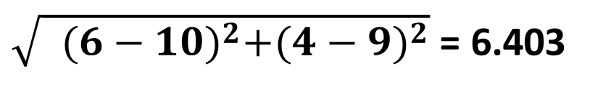
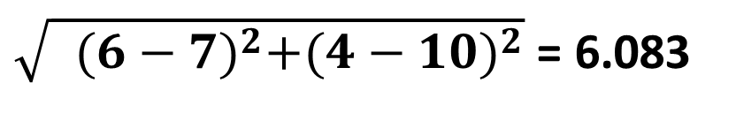
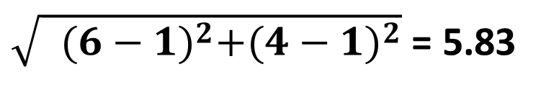
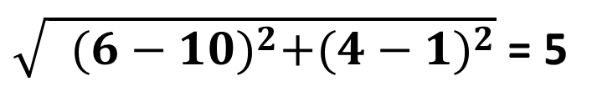
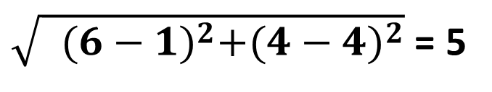
K-Nearest Neighbor Classifier
$\sqrt{{ {(6−7)}^{2}+(4−10)}^{2}}$ = 6.083
dist(tomato,carrot) =
$\sqrt{{ {(6−10)}^{2}+(4−9)}^{2}}$ = 6.403
dist(tomato,apple) =
$\sqrt{{ {(6−1)}^{2}+(4−4)}^{2}}$ = 5
dist(tomato,bacon) =
$\sqrt{{ {(6−10)}^{2}+(4−1)}^{2}}$ = 5
dist(tomato,banana) =
$\sqrt{{ {(6−1)}^{2}+(4−1)}^{2}}$ = 5.83
dist(tomato,cheese) =

Slide 55





K-Nearest Neighbor Classifier
dist(tomato,carrot) =
$\sqrt{{ {(6−7)}^{2}+(4−10)}^{2}}$ = 6.083
dist(tomato,apple) =
$\sqrt{{ {(6−10)}^{2}+(4−9)}^{2}}$ = 6.403
dist(tomato,bacon) =
$\sqrt{{ {(6−1)}^{2}+(4−4)}^{2}}$ = 5
dist(tomato,banana) =
$\sqrt{{ {(6−10)}^{2}+(4−1)}^{2}}$ = 5
dist(tomato,cheese) =
$\sqrt{{ {(6−1)}^{2}+(4−1)}^{2}}$ = 5.83
k=1
we consider the smallest distance: bacon and banana
k=2
we consider the 2 smallest distances: bacon and banana
50%-50% that tomato is a fruit or a protein
k=3
we consider the 3 smallest distances: bacon, banana and cheese
So tomato appears to be a protein !!!

Slide 56
K-Nearest Neighbor Classifier
HOW TO CHOOSE THE OPTIMAL K VALUE
deciding how many neighbors to use for kNN → determines how well the model will generalize and work on other datasets
k is small → noisy data or outliers have a huge impact on our classifier ... this is called „underfitting”
k is large → the classifier has the tendency to predict the majority class regardless of which neighbors are nearest ... this is called „overfitting”

Slide 57
Normalization
features are usually transformed into a range before the kNN algorithm is applied
WHY?
the distance formula depends on how features are measured
if certain features have much larger values than others → the distance measurements will be strongly dominated by the larger values
we have to rescale the various features such that each one contributes relatively equally to the distance formula
1.) min-max normalization
2.) z-transformation

Slide 58
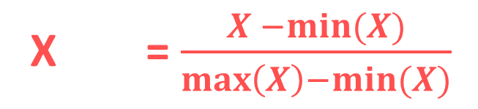
Normalization
MIN-MAX NORMALIZATION
→ this process transforms a feature such that all of its values fall in a range
between 0 and 1
normalized feature values can be interpreted as indicating how far, from 0%
to 100%, the original value fall along the range between the original minima and
maxima
X = $\frac{X −min⁡(X)}{\max\left(X\right)−min⁡(X)}$
new

Slide 59
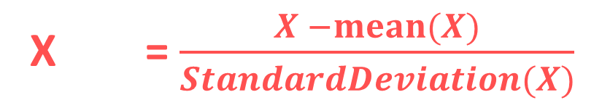
Normalization
Z-SCORE NORMALIZATION (STANDARDIZATION)
it is a way of normalizing the dataset as well: the algorithm
uses mean and standard deviation to do so
X = $\frac{X −mean⁡(X)}{StandardDeviation(X)}$
new
For Principle Component Analysis we prefer using z-score normalization
~ but for image processing: pixel intensities have to be normalized to fit within a
certain range + neural networks requires data that on a 0-1 scale

Slide 60
Naive Bayes Classifier
very efficient supervised learning algorithm
it scales well even in high dimensions !!!
it is able to compete with SVM or random forest classifiers
it is able to make good predictions even when the training data is relatively small
Why is it naive?
The naive assumption is that every pair
of features are independent

Slide 61
Naive Bayes Classifier
Naive means there is a strong independence assumptions between the given features
For example: a fruit can be considered to be an apple if it is red, rounded and
about 8cm in diameter
~ Naive Bayes Classifier considers each of these features contribute independently
to the probability that this fruit is an apple
(do not care about the correlation between color, roundness and diameter)

Slide 62
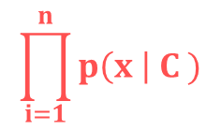
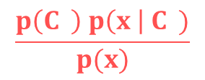
Naive Bayes Classifier
ABSTRACT MATHEMATICAL APPROACH
x are the features
P(C | x x ... x )
this model relies heavily on conditional probability
k
1
2
n
C is the possible
outcome of k classes
$$\frac{p\left(C \right) p\left(x \right| C )}{p(x)}$$
this is the Bayes theorem, we can decompose the
conditional probability
P(C | x x ... x ) =
k
-
k
k
1
2
n
-
the same for all c values
k
P( x x ... x | C ) = P(x | C ) P(x | C ) ... P(x | C )
INDEPENDENT FEATURES !!!
1
2
n
k
1
k
2
k
n
k
$$\prod_{i=1}^{n}{p\left(x \right| C )}$$
P(C | x x ... x ) p(C )
k
1
2
n
~
k
i
k

Slide 63
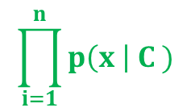
Naive Bayes Classifier
ABSTRACT MATHEMATICAL APPROACH
If we assume the features are independent we can come up with
a powerful probability-based classification algorithm
→ we have to choose the C class with the highest probability
k
$$\prod_{i=1}^{n}{p\left(x \right| C )}$$
C = arg max
p(C )
c
k
i
k
k
„Naive Bayes Classifier”

Slide 64
Naive Bayes Classifier
ADVANTAGES
→ relatively simple to understand
→ it can be trained on small datasets as well
→ it is a fast approach
→ it is not sensitive to irrelevant features
DISADVANTAGES
it assumes every feature is independent: of course
it is not always true !!!

Slide 65
Naive Bayes Classifier
Why is it so powerful for text classification?
The two assumptions of Naive Bayes Classifier:
→ the probability of occurrence of any word given the class label
is independent of the probability of occurrence of any other word given that label
→ the probability of occurrence of a word in a document is independent of the
location of that word within the document
It is the same assumption of bag-of-words model: documents are just
a bunch of words thrown together
THESE ASSUMPTIONS ARE TRUE FOR TEXT CLASSIFICATION !!!

Slide 66
Naive Bayes Classifier

Slide 67
Naive Bayes Classifier
?

Slide 68


Naive Bayes Classifier
P(yellow) = $\frac{7}{17}$
P(green) = $\frac{10}{17}$
?

Slide 69
Naive Bayes Classifier
P(yellow) = $\frac{7}{17}$
P(green) = $\frac{10}{17}$
?

Slide 70


Naive Bayes Classifier
P(yellow) = $\frac{7}{17}$
P’(? | green) = $\frac{3}{10}$
P(green) = $\frac{10}{17}$
P’(? | yellow) = $\frac{1}{7}$
?

Slide 71
Naive Bayes Classifier
P(yellow) = $\frac{7}{17}$
P’(? | green) = $\frac{3}{10}$
P(green) = $\frac{10}{17}$
P’(? | yellow) = $\frac{1}{7}$
?
posterior probability P’’(? is green ) = P(green) * P’(? | green) = $\frac{10}{17}$ * $\frac{3}{10}= \frac{30}{170}$
posterior probability P’’(? is yellow ) = P(yellow) * P’(? | yellow) = $\frac{7}{17}$ * $\frac{1}{7}= \frac{7}{119}$

Slide 72
Naive Bayes Classifier
P(yellow) = $\frac{7}{17}$
P’(? | green) = $\frac{3}{10}$
P(green) = $\frac{10}{17}$
P’(? | yellow) = $\frac{1}{7}$
?
posterior probability P’’(? is green ) = P(green) * P’(? | green) = $\frac{10}{17}$ * $\frac{3}{10}= \frac{30}{170}$
posterior probability P’’(? is yellow ) = P(yellow) * P’(? | yellow) = $\frac{7}{17}$ * $\frac{1}{7}= \frac{7}{119}$

Slide 73
Decision Trees
Decision Tree is a type of supervised learning approaches: mostly used in classification
problems but it can be used for regression as well
~ works fine for both categorical variables and continuous input as well
→ very similar to search trees
→ split the data/population into two or more homogeneous sets
based on significant splitter in input variables

Slide 74
Decision Trees
Decision Tree is a type of supervised learning approaches: mostly used in classification
problems but it can be used for regression as well
~ works fine for both categorical variables and continuous input as well
→ very similar to search trees
→ split the data/population into tow or more homogeneous sets
based on significant splitter in input variables
For example: we have a single
feature x, the number of hours a
student spent with studying
Want to predict the y probability
of passing the exam
we split on x
x < 5
x > 5
Categorical Variable Decision Tree:
→ categorical target variable such as yes/no or fail/pass
Continuous Variable Decision Tree:
→ continuous target variable: such as for regression
FAIL
PASS

Slide 75
Decision Trees
root node: represent the entire dataset/population and this
further gets divided into several subsets
~ root node corresponds to the best predictor
decision node: the algorithm splits the
node into sub-nodes based on given
feature in the dataset
leaf nodes: with no children
~ the values are what we are after
HOW TO DECIDE WHAT NODES (FEATURES) ARE IMPORTANT?
WHAT SHOULD BE THE ROOT NODE?

Slide 76
Decision Trees
Decision Tree classifier accuracy depends heavily on splits
Hot to construct the tree? What are the nodes?
There are several algorithms for this problem:
1.) Gini Index Approach
2.) Calculating the information entropy (ID3 algorithm or C4.5 approach)
3.) algorithm based on variance reduction

Slide 77
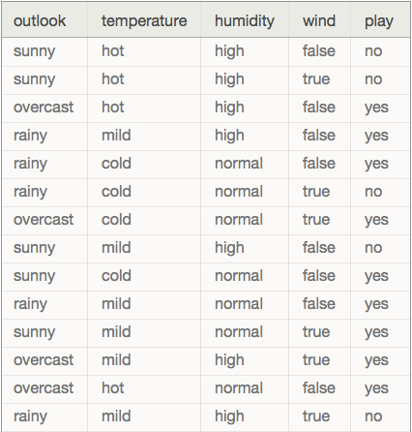
Decision Trees
We are dealing with categorical variables (predictors)
or features: outlook, temperature, humidity, wind
~ we want to predict whether to play
golf or not (play is he target variable)

Slide 78
Decision Trees
OUTLOOK
SUNNY
OVERCAST
RAINY
WINDY
YES
HUMIDITY
TRUE
FALSE
HIGH
NORMAL
YES
NO
NO
YES

Slide 79
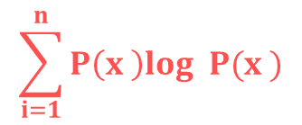
Decision Trees
Usually ID3 algorithm is used to build the decision tree:
~ it is a top-down greedy search of possible branches
→ it uses entropy and information gain to build the tree
The H(X) Shannon-entropy of a dicrete random variable X with possible values
x x ... x and probability mass function P(X) is defined as:
1
2
n
$$\sum_{i=1}^{n}{P\left(x \right)log P(x )}$$
H(X) = -
i
2
i
Example: https://en.wikipedia.org/wiki/Entropy_(information_theory)
For completely homogoeneous dataset (all TRUE or all FALSE values): entropy is 0
If the dataset is equally divided (same amount of TRUEs and FALSEs): entropy is 1
A BRANCH WITH ENTROPY MORE THAN 1 NEEDS SPLITING !!!
+ root node has the maximum information gain (entropy reduction)
+ leaf nodes have entropy 0

Slide 80
Decision Trees
PLAYING GOLF
→ 9 times YES
→ 5 times NO
We just have to use the Shannon-entropy formula
to calculate the H(x) values
H(PlayingGolf) = H(9,5) =
= -(0.64 log 0.64) – (0.36 log 0.36) = 0.94
2
2

Slide 81
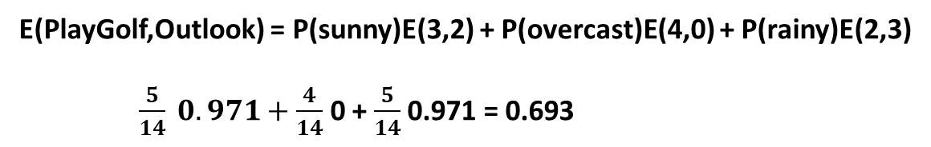
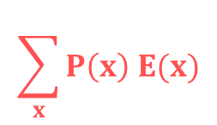
Decision Trees
$$\sum_{x}{P\left(x\right) E(x)}$$
E(T,X) =
We have to calculate the entropy with respect to
a given predictor/feature in order to be able to
calculate information gain
PLAY GOLF
YES NO
sunny 3 2
overcast 4 0
rainy 2 3
OUTLOOK
E(PlayGolf,Outlook) = P(sunny)E(3,2) + P(overcast)E(4,0) + P(rainy)E(2,3)
$\frac{5}{14} 0.971+\frac{4}{14}$ 0 + $\frac{5}{14}$ 0.971 = 0.693

Slide 82
Decision Trees
Information gain: the decrease in entropy after a dataset is
split on an attribute/feature
→ feature/attribute with the highest information
gain will be the root node in the tree
Information Gain = H(PlayGolf) - E(PlayGolf,Outlook) =
= 0.64 – 0.693 = 0.247
PLAY GOLF
YES NO
sunny 3 2
overcast 4 0
rainy 2 3
OUTLOOK

Slide 83
Decision Trees
Information gain: the decrease in entropy after a dataset is
split on an attribute/feature
→ feature/attribute with the highest information
gain will be the root node in the tree
Information Gain (outlook) = 0.247
Information Gain (temperature) = 0.029
Information Gain (humidity) = 0.152
Information Gain (wind) = 0.048

Slide 84
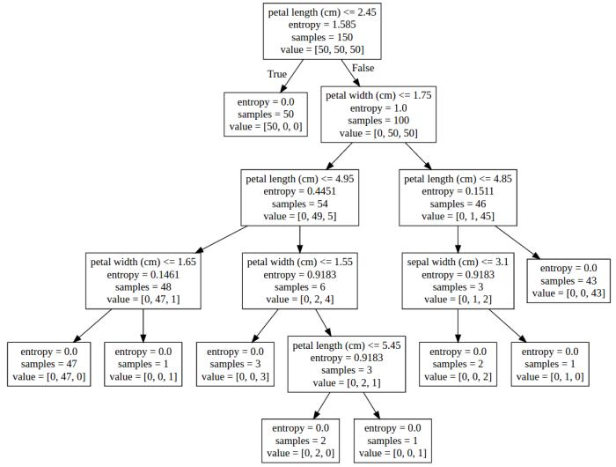
Decision Trees
IRIS-SETOSA
IRIS-VERSICOLOR
IRIS-VIRGINICA

Slide 85
Decision Trees
Most significant problem: every split it makes at each node is
optimized for the dataset it is fit to
~ this splitting process will rarely generalize well to other data !!!

Slide 86
Decision Trees
ADVANTAGES
easy to understand and interpret
it is one of the best approaches to identify most significant variables
and the relationships between the variables
no need for data preprocessing
Decision trees are not influenced by outliers for example
can handle numerical variables as well as categorical variables
Categorical variables: YES/NO or SUNNY/RAINY
DISADVANTAGES
have the tendency to overfit
~ we can solve it by pruning for example
decision trees can be unstable because small variations in the data might
result in a completely different tree being generated
~ generating the optimal tree is NP-complete: heuristic solutions are used (greedy approach)

Slide 87
Gini Index Approach
CART (Classification and Regression Tree) algorithm uses Gini indexes to
decide how to make the splits
using Gini Index Approach is a bit better than
calculating the information gain and entropy
THE ALGORITHMS ARE APPROXIMATELY THE SAME !!!
when dealing with entropy: we have to calculate logarithmic
functions, which are computationally expensive
~ thats why we prefer Gini Index Approach

Slide 88

Gini Index Approach
$$\sum_{i=1}^{n}{P\left(x \right)}$$
G(X) = 1 -
2
i
This is the formula we have to use in order to calculate
the Gini-index of a X random variable
E(s,t) = G(t) – P(left) G(left_t) – P(right) G(right_t)
As we have seen for Information Gain, here as well we have to calculate
the Gini-index concerning a given split
WE SPLIT THE FEATURE WITH THE LOWEST GINI-INDEX

Slide 89
Gini Index Approach
PLAYING GOLF
→ 9 times YES
→ 5 times NO
We just have to use the Gini-index formula
to calculate the G(x) values
G(PlayingGolf) = G(9,5) =
= 1 - 0.64 - 0.36 = 0.46
2
2

Slide 90


Gini Index Approach
E(s,t) = G(t) – P(left) G(left_t) – P(right) G(right_t)
Gini-index for
input node t
proportion of observation
in the left node after splitting
+ Gini-index of the left node
after splitting
proportion of observation
in the right node after splitting
+ Gini-index of the right node
after splitting
DEFAULT
YES NO
GENDER
male 3 2
female 4 0
$$(\frac{7}{9})$$
$$(\frac{2}{9})$$
2
2
G(t) = 1 - - = 0.3432

Slide 91






Gini Index Approach
E(s,t) = G(t) – P(left) G(left_t) – P(right) G(right_t)
Gini-index for
input node t
proportion of observation
in the left node after splitting
+ Gini-index of the left node
after splitting
proportion of observation
in the right node after splitting
+ Gini-index of the right node
after splitting
DEFAULT
YES NO
GENDER
male 3 2
female 4 0
$$(\frac{3}{5})$$
$$(\frac{2}{5})$$
2
2
G(male) = 1 - - = 0.48
$$(\frac{4}{4})$$
$$(\frac{0}{4})$$
2
2
G(female) = 1 - - = 0
$$\frac{5}{9}$$
$$\frac{4}{9}$$
E(s,t) = 0.34 – 0.48 - 0 = 0.07

Slide 92
Pruning and Bagging
What is the aim when dealing with machine learning algorithms? We want to choose
a model that capture the relatinships within the training dataset
+ generalizes well to unseen data (test set)
GENERALLY IT IS IMPOSSIBLE TO ACHIEVE BOTH OF THEM AT THE SAME TIME
~ this is called the bias-variance trade-off

Slide 93
Pruning and Bagging
bias: error from misclassifications in the learning algorithm
High bias → the algorithm misses the relevant relationships
between features and target outputs (underfitting)
ERROR DUE TO MODEL MISMATCH
variance: error from sensitivity to small changes in the training set
High variance → can cause overfitting (the algorithm models the noise)
VARIATION DUE TO TRAINING SAMPLE AND RANDOMIZATION
bias / variance trade-off
~ we are not able to optimize both bias and variance at the same time
low bias → high variance
low variance → high bias

Slide 94
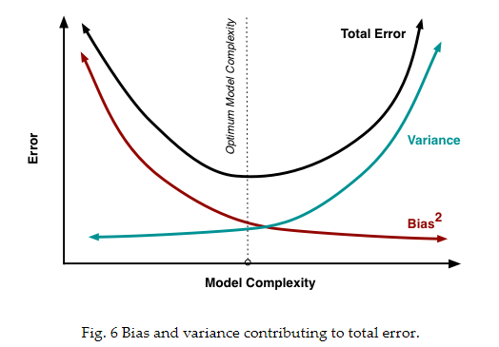
Pruning and Bagging
http://scott.fortmann-roe.com/docs/BiasVariance.html

Slide 95
Pruning
usually decision trees are likely to overfit the data leading to poor test performance
+ trees are unstable classifiers: if you perturb the data a little the tree might significantly change
(low bias but high variance model !!!)
smaller tree + fewer splits → better predictor at the cost of a little extra bias
better solution: grow a large tree and then prune it back to a smaller subtree
„weakest link pruning”

Slide 96
Pruning
BEFORE PRUNING

Slide 97
Pruning
AFTER PRUNING

Slide 98
Bagging
BOOTSTRAP AGGREGATION
A rather counter-intuitive theory: a weak learner is not able to make
good predictions
→ weak learner is just a bit better than random guess or coin flip
For example: decision trees with depth 1
→ combining weak learners can prove to be an extremely
powerful classifier !!!
„wisdom of the crowd”
(Black-Scholes model is approximately the same: two risky
positions taken together can effectively eliminate risk itself)

Slide 99
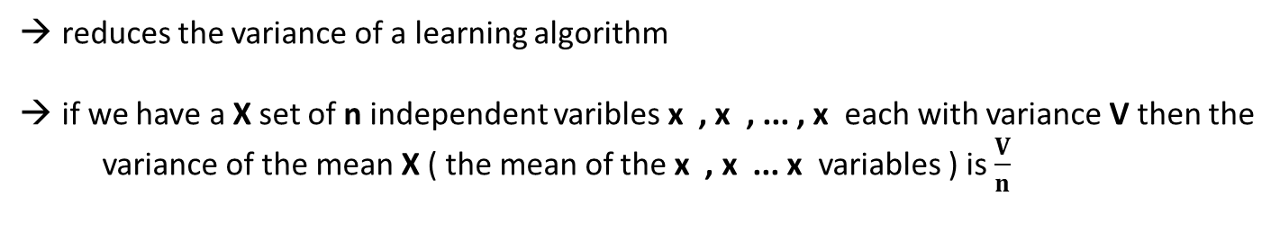
Bagging
BOOTSTRAP AGGREGATION
reduces the variance of a learning algorithm
if we have a X set of n independent varibles x , x , ... , x each with variance V then the
variance of the mean X ( the mean of the x , x ... x variables ) is $\frac{V}{n}$
1
2
n
1
2
n
WE CAN REDUCE THE VARIANCE BY AVERAGING A SET OF OBSERVATIONS !!!
good idea: have multiple training sets and construct a decision tree (without pruning)
on every single training set !!!
→ PROBLEM: we do not have several training sets

Slide 100
Bagging
BOOTSTRAP AGGREGATION
we should take repeated samples from the single data set + construct trees + average
all the predictions in the end
~ all the trees are fully grown unpruned decision trees
THIS IS CALLED BAGGING !!!
pruning: variance decreases but we have some bias ... here we can reduce
the variance without extra bias
Regression problem: we take the average
Classification problem: we take the majority vote

Slide 101
Bagging
BOOTSTRAP AGGREGATION
One problem with bagging: the constructed trees are highly correlated
Why do correlation occur?
Because every dataset has a strong predictor/feature. All the bagged trees
tend to make the same splits because they all share the same features !!!
~ because of this all of these trees look very similar
TREE #1
TREE #2
TREE #3
TREE #4
CORRELATED TREES BECAUSE WE USE ALL THE FEATURES

Slide 102
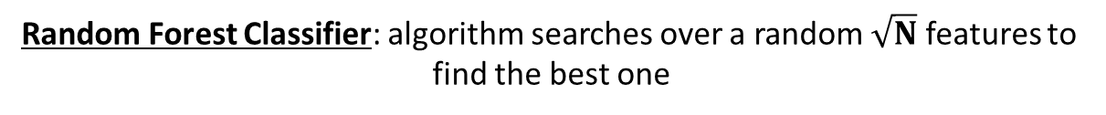
Random Forest Classifier
better than bagging: this algorithm decorrelates the single decision trees that has been constructed
this reduces the variance even more when averaging the trees
similar to bagging: we keep constructing decision trees on the training data BUT on every split in the tree, a random selection of features / predictors is chosen from the full feature set
The number of features considered at a given split is approximately equal to the square root of the total number of features (for classification)
Bagging: algorithm searches over all the N features to find
the best feature that best splits the data at that node
Random Forest Classifier: algorithm searches over a random $\sqrt{N}$ features to
find the best one

Slide 103
Random Forest Classifier
X dataset
N features
N features
N features
N features
1
2
3
4
TREE #1
TREE #2
TREE #3
TREE #4
CLASS C
CLASS D
CLASS B
CLASS C
MAJORITY VOTING
FINAL CLASS

Slide 104
Random Forest Classifier
Why is it good?
if one or a few features are very strong predictors for the response variable (target output), these features will be selected in many of the decision trees: so they will become correlated
huge advantage: at some point the variance stops decreasing no matter how many more trees we add to our random forest + it is not going to produce overfitting !!!

Slide 105
Boosting
it can be used for classification and regression too
helps to reduce variance and bias !!!
bagging: creates multiple copies of the original data: constructs several decision trees on the copies and combining all the trees to make predictions
WE CONSTRUCT THESE TREES INDEPENDENTLY !!!
boosting: here the decision trees are grown sequentially so each tree is grown using information from previously grown trees
THESE TREES ARE NOT INDEPENDENT OF EACH OTHER
~ boosting is a sequential learning algorithm

Slide 106
Boosting
A rather counter-intuitive theory: a weak learner is not able to make
good predictions
→ weak learner is just a bit better than random guess or coin flip
For example: decision trees with depth 1
→ combining weak learners can prove to be an extremely
powerful classifier !!!
→ by fitting small trees (decision stumps) we slowly improve the final result
in cases when it does not perform well
We will consider adaptive boosting „AdaBoost” algorithm !!!

Slide 107
Boosting Applications
Viola-Jones Face Detection algorithm uses boosting
~ combines decision stumps to detect faces
→ weak learners decide whether the given section of the image
contains a face or not
→ extremely accurate and fast algorithm

Slide 108
Boosting
For example: we want to classify the dots
~ two x features + two output classes (yellow and green)
Boosting: combines very simple weak learners such as
decision trees with depth 1 (capable of linear classification)
x
2
x
1

Slide 109
Boosting
For example: we want to classify the dots
~ two x features + two output classes (yellow and green)
Boosting: combines very simple weak learners such as
decision trees with depth 1 (capable of linear classification)
→ the classifier made 2 mistakes: two yellow
dots are misclassified
→ boosting algorithm: in the next iteration it
will focus on the misclassified items
Increase the w weights: for misclassified items
Decrease the w weights: for correctly classified items
x
2
x
1

Slide 110
Boosting
For example: we want to classify the dots
~ two x features + two output classes (yellow and green)
Boosting: combines very simple weak learners such as
decision trees with depth 1 (capable of linear classification)
→ the classifier made 2 mistakes: two yellow
dots are misclassified
→ boosting algorithm: in the next iteration it
will focus on the misclassified items
Increase the w weights: for misclassified items
Decrease the w weights: for correctly classified items
x
2
x
1

Slide 111
Boosting
For example: we want to classify the dots
~ two x features + two output classes (yellow and green)
Boosting: combines very simple weak learners such as
decision trees with depth 1 (capable of linear classification)
→ the classifier made 2 mistakes: two yellow
dots are misclassified
→ boosting algorithm: in the next iteration it
will focus on the misclassified items
Increase the w weights: for misclassified items
Decrease the w weights: for correctly classified items
x
2
x
1

Slide 112
Boosting
For example: we want to classify the dots
~ two x features + two output classes (yellow and green)
Boosting: combines very simple weak learners such as
decision trees with depth 1 (capable of linear classification)
→ the classifier made 2 mistakes: two yellow
dots are misclassified
→ boosting algorithm: in the next iteration it
will focus on the misclassified items
Increase the w weights: for misclassified items
Decrease the w weights: for correctly classified items
x
2
x
1
WE JUST HAVE TO COMBINE THESE WEAK CLASSIFIERS !!!

Slide 113
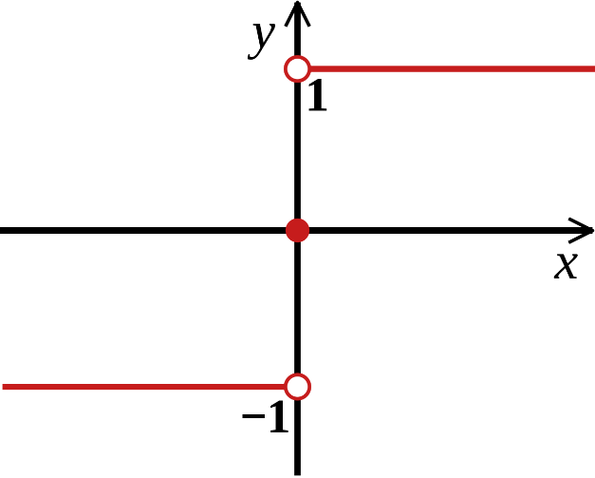
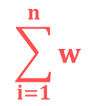

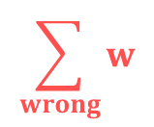

Boosting
we keep combining h(x)
weak learners (each learner knows just a
little fraction of the space)
$$\sum_{i=1}^{n}{α h \left(x\right)}$$
H(x) = sign
i
i
final H(x) model which
is a strong classifier
// we assign +1 and -1 for the output classes (yellow and green)
$$\frac{1}{N}$$
→ we initialize the weights parameters at the beginning w =
i
$$\sum_{i=1}^{n}{w}$$
= 1
we make sure this is a distribution
i
$$\sum_{wrong}{w}$$
ε =
error is the sum of the misclassified weights
i

Slide 114




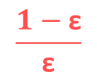



Boosting
$$\frac{1}{N}$$
initialize the weights at the beginning
w =
i
pick h (x) that minimizes
the ε error term
$$\sum_{wrong}{w}$$
t
ε =
t
i
$$\frac{1}{\text{2}}$$
$$\frac{1−\text{ε}}{\text{ε}}$$
we can calculate $α$
t
$α$ = ln ( )
t
t
t
t
- $α$ h (x) y(x)
t+1
$$\frac{w}{\text{Z}}$$
i
t
t
update w weight
w = e
t+1
i
On every iteration we add a new h(x) weak learner to the final model

Slide 115
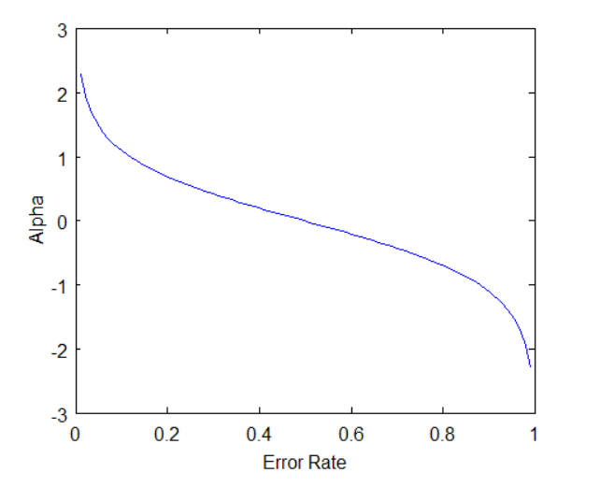



Boosting
$$\frac{1}{\text{2}}$$
$$\frac{1−\text{ε}}{\text{ε}}$$
t
$α$ = ln ( )
t
t
given h(x) classifier α value increases as the error
converges to 0: of course, good classifiers are
given more weight
given h(x) classifier α value is 0 if the error is 0.5
Why? Because it is a random guess (coin toss)
~ we do not want our algorithm to rely on random guesses
we give negative α value for h(x) classifiers that are worse
than random guesses
~ we do the opposite thats the best action
This α parameter as something to do with the h(x) learners !!!

Slide 116


Boosting
t
- $α$ h (x) y(x)
this is how we update the weights
in every iteration
t+1
$$\frac{w}{\text{Z}}$$
i
t
t
w = e
i
the w weights have something to do with the dataset
we set higher weights to more important samples and lower weight
values to less important ones
→ the Z makes sure w is a distribution so the sum is 1
→ y(x) flips the sign of the exponent if h(x) is wrong
Why is it good? It makes sure to assign smaller weights to samples
that are correctly classified and bigger weights for misclassification
~ in the next iteration the next h(x) learner can focus on those samples with higher weights
Why to use α in the formula? This is how we make sure that stronger classfiers’ decisions are more important
If a weak classifier misclassifies an input we do not take that
as seriously as a strong classifier’s mistake

Slide 117
Boosting and Bagging
BAGGING BOOSTING
both bagging and boosting use N learners + yields more stable models
every item has the same probability
to appear in a new dataset
the samples are weighted so some
of them will occur more often
parallel training stage
builds learners in sequential way
final decision is the average
of the N learners
final decision is the weighted average
of the N learners
(better classifiers have higher weights)
reduces variance and
solves over-fitting
reduces bias but
increases over-fitting a bit
PREFERRED

Slide 118
Computer Vision
So far we have been dealing with known datasets
MNIST handwritten digit dataset: we know that there are 28x28 pixels image
+ we know that there are 10 output classes
Olivetti Faces dataset: contains 64x64 pixels images
WE KNOW WHAT WE ARE LOOKING FOR
Computer vision: we are after a general solution
If we have a given image → we want to make sure the algorithm is able to
detect and recognize objects (faces, cars or horses)

Slide 119
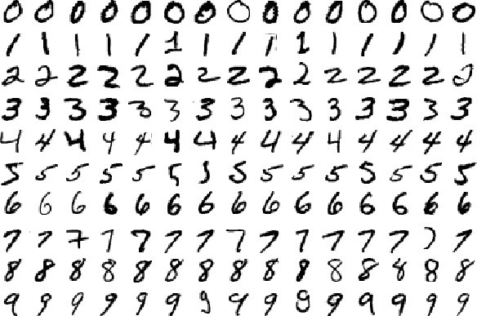
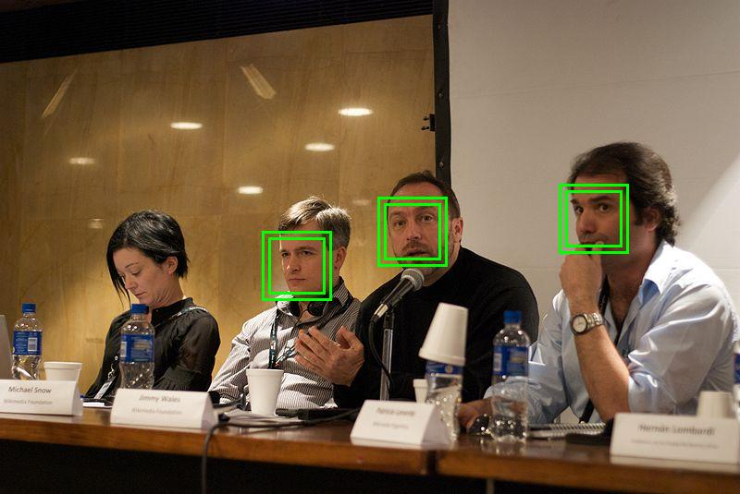
Computer Vision
we can tune the given machine learning
algorithm or neural networks to deal
with this specific task
we have to find the object on the image
and make sure our detection
algorithm is correct

Slide 120
Viola-Jones Algorithm
This algorithm tries to find the most relevant
features for a human face (we are dealing with face detection)
→ what are relevant features for detecting faces?
→ two eyes, nose, lips, forehead ...
→ we can construct an algorithm based on the most relevant
features: if the algorithm does not find one of these
features it comes to the conclusion that there is no
human face on that region of the image
THIS ALGORITHM HANDLES GRAYSCALE IMAGES
~ so the first step is to convert the image into grayscale

Slide 121

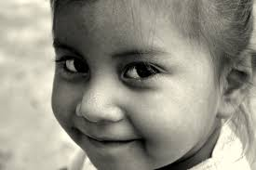
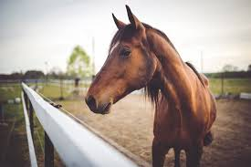

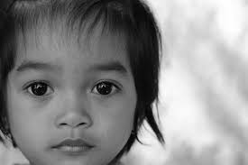

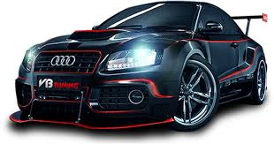
Viola-Jones Algorithm
The algorithm was formulated by Paul Viola and Michael Jones in 2001
→ it is a machine learning algorithm: so it needs training as well
~ training phase + testing (detecting the objects)
→ the algorithm needs positive images (images of faces) and
negative images (images without faces) as well
~ this is how it learns the most relevant feature

Slide 122
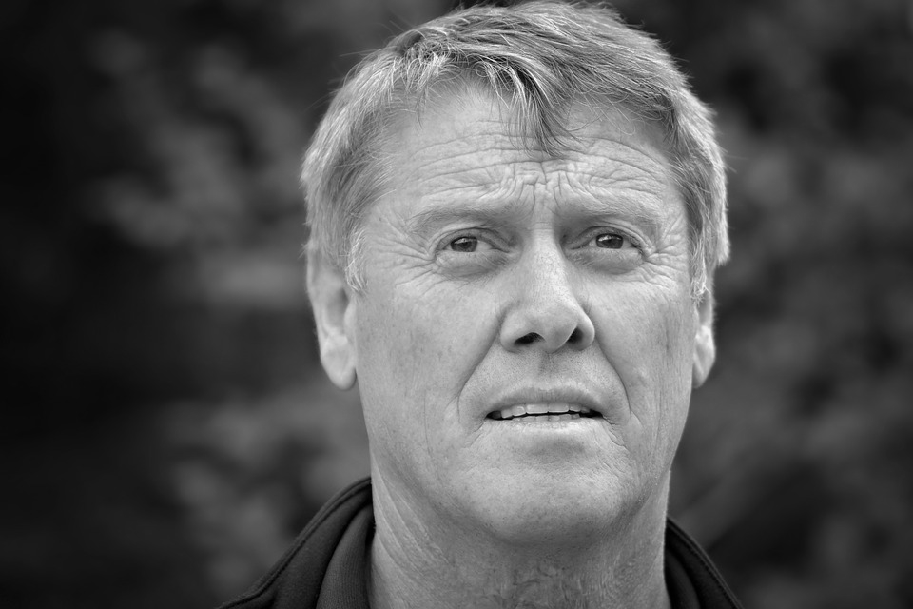
Viola-Jones Algorithm

Slide 123
Viola-Jones Algorithm

Slide 124
Viola-Jones Algorithm

Slide 125
Viola-Jones Algorithm

Slide 126
Viola-Jones Algorithm

Slide 127
Viola-Jones Algorithm

Slide 128
Viola-Jones Algorithm

Slide 129
Viola-Jones Algorithm

Slide 130
Viola-Jones Algorithm

Slide 131
Viola-Jones Algorithm

Slide 132
Viola-Jones Algorithm

Slide 133
Viola-Jones Algorithm

Slide 134
Viola-Jones Algorithm

Slide 135
Viola-Jones Algorithm

Slide 136
Viola-Jones Algorithm

Slide 137
Viola-Jones Algorithm

Slide 138
Viola-Jones Algorithm

Slide 139
Viola-Jones Algorithm

Slide 140
Viola-Jones Algorithm

Slide 141
Viola-Jones Algorithm
We have a huge problem with this approach: size of faces may differ
(window size is too small to include all the relevant features of a face
so the algorithm will not work fine)
~ some faces may be closer to the camera which means they
appear bigger than other faces in the background
scaleFactor: this feature in OpenCV compensates for this issue
The training uses 24x24 pixels images so we have to rescale the input image
~ so we can resize a larger face to a smaller one

Slide 142
Haar-features
Haar-wavelet is a sequence of rescaled square-shaped „functions”
~ very similar to Fourier-analysis
→ it was proposed by Alfréd Haar in 1909
→ they are like convolutional kernels
HAAR FEATURES ARE THE RELEVANT FEATURES FOR FACE DETECTION
edge features can detect edges
quite effectively
line features can detect lines
quite effectively

Slide 143
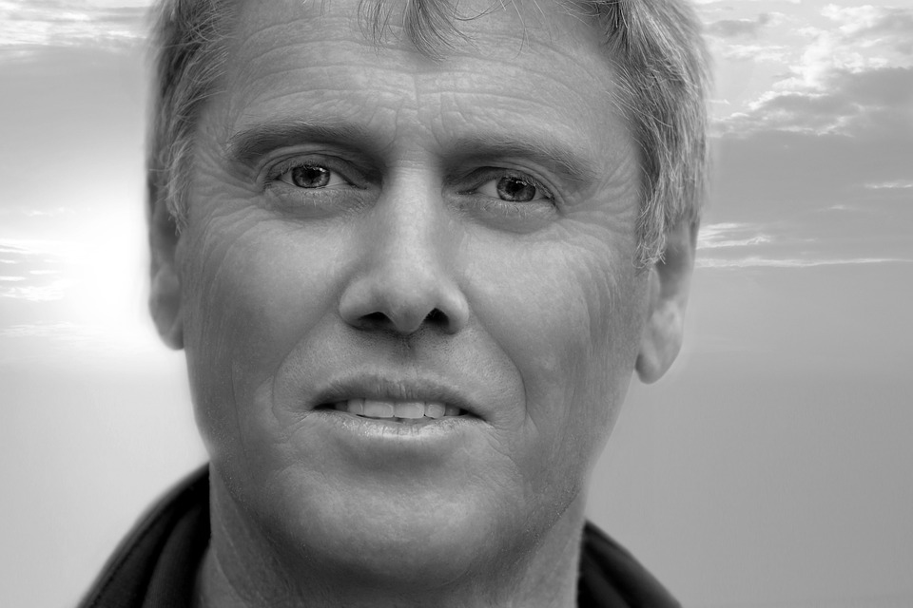
Haar-features

Slide 144
Haar-features
WE CAN REPRESENT THE MOST RELEVANT FEATURES WITH HAAR-FEATURES !!!

Slide 145

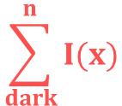

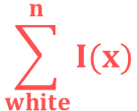
Haar-features
Viola-Jones algorithm will compare
how close the real scenario is to the
ideal case
1.) let’s sum up the white
pixel intensities
2.) calculate the sum of the
black pixel intensities
0
0
1
1
0.1
0.2
0.6
0.8
0
0
1
1
0.2
0.3
0.8
0.6
0
0
1
1
0.2
0.1
0.6
0.8
0
0
1
1
0.2
0.1
0.8
0.9
ideal Haar-feature
pixel intensities
0: white
1: black
these are real values
detected on an image
$$\frac{1}{n}$$
$$\sum_{dark}^{n}{I(x)}$$
$$\frac{1}{n}$$
$$\sum_{white}^{n}{I(x)}$$
Δ = dark – white =
-
Δ for ideal Haar-feature is 1
Δ for the real image: 0.74 – 0.18 = 0.56
The closer the value to 1, the more likely we have found a Haar-feature !!!
(of course we will never get 0 or 1: there are thresholds)

Slide 146
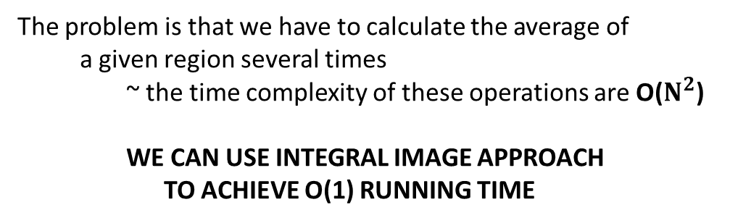
Integral Image
0.1
0.1
0.2
0.1
0.7
0.1
The problem is that we have to calculate the average of
a given region several times
~ the time complexity of these operations are O($N^{2}$)
WE CAN USE INTEGRAL IMAGE APPROACH
TO ACHIEVE O(1) RUNNING TIME
0.2
0.3
0.2
0.7
0.8
0.2
0.1
0.4
0.3
0.3
0.1
0.3
0.1
0.5
0.1
0.1
0.2
0.8
Why are there so many operations?
Because we have to use Haar-features with all
possible sizes and locations
~ 200k features to calculate !!!
→ every time we have to use a quadratic algorithm
~ we have to find a better approach
0.1
0.4
0.8
0.5
0.6
0.5
these are the same
kernels but with
different sizes

Slide 147
Integral Image
0.1
0.1
0.2
0.1
0.7
0.1
0.1
0.2
0.4
0.5
1.2
1.3
0.2
0.3
0.2
0.7
0.8
0.2
0.3
0.7
1.1
1.9
3.4
3.7
0.1
0.4
0.3
0.3
0.1
0.3
0.4
1.2
1.9
3.0
4.6
5.2
0.1
0.5
0.1
0.1
0.2
0.8
0.5
1.7
2.5
3.7
5.3
6.7
0.1
0.4
0.8
0.5
0.6
0.5
0.6
2.3
3.9
5.6
8.0
9.9
original image
integral image

Slide 148
Integral Image
0.1
0.1
0.2
0.1
0.7
0.1
0.1
0.2
0.4
0.5
1.2
1.3
0.2
0.3
0.2
0.7
0.8
0.2
0.3
0.7
1.1
1.9
3.4
3.7
0.1
0.4
0.3
0.3
0.1
0.3
0.4
1.2
1.9
3.0
4.6
5.2
0.1
0.5
0.1
0.1
0.2
0.8
0.5
1.7
2.5
3.7
5.3
6.7
0.1
0.4
0.8
0.5
0.6
0.5
0.6
2.3
3.9
5.6
8.0
9.9
original image
integral image

Slide 149
Integral Image
0.1
0.1
0.2
0.1
0.7
0.1
0.1
0.2
0.4
0.5
1.2
1.3
0.2
0.3
0.2
0.7
0.8
0.2
0.3
0.7
1.1
1.9
3.4
3.7
0.1
0.4
0.3
0.3
0.1
0.3
0.4
1.2
1.9
3.0
4.6
5.2
0.1
0.5
0.1
0.1
0.2
0.8
0.5
1.7
2.5
3.7
5.3
6.7
0.1
0.4
0.8
0.5
0.6
0.5
0.6
2.3
3.9
5.6
8.0
9.9
original image
integral image

Slide 150
Integral Image
0.1
0.1
0.2
0.1
0.7
0.1
0.1
0.2
0.4
0.5
1.2
1.3
0.2
0.3
0.2
0.7
0.8
0.2
0.3
0.7
1.1
1.9
3.4
3.7
0.1
0.4
0.3
0.3
0.1
0.3
0.4
1.2
1.9
3.0
4.6
5.2
0.1
0.5
0.1
0.1
0.2
0.8
0.5
1.7
2.5
3.7
5.3
6.7
0.1
0.4
0.8
0.5
0.6
0.5
0.6
2.3
3.9
5.6
8.0
9.9
original image
integral image

Slide 151
Integral Image
0.1
0.1
0.2
0.1
0.7
0.1
0.1
0.2
0.4
0.5
1.2
1.3
0.2
0.3
0.2
0.7
0.8
0.2
0.3
0.7
1.1
1.9
3.4
3.7
0.1
0.4
0.3
0.3
0.1
0.3
0.4
1.2
1.9
3.0
4.6
5.2
0.1
0.5
0.1
0.1
0.2
0.8
0.5
1.7
2.5
3.7
5.3
6.7
0.1
0.4
0.8
0.5
0.6
0.5
0.6
2.3
3.9
5.6
8.0
9.9
original image
integral image
SUM = 3.7

Slide 152
Integral Image
0.1
0.1
0.2
0.1
0.7
0.1
0.1
0.2
0.4
0.5
1.2
1.3
0.2
0.3
0.2
0.7
0.8
0.2
0.3
0.7
1.1
1.9
3.4
3.7
0.1
0.4
0.3
0.3
0.1
0.3
0.4
1.2
1.9
3.0
4.6
5.2
0.1
0.5
0.1
0.1
0.2
0.8
0.5
1.7
2.5
3.7
5.3
6.7
0.1
0.4
0.8
0.5
0.6
0.5
0.6
2.3
3.9
5.6
8.0
9.9
original image
integral image
SUM = 3.7 – 0.5

Slide 153
Integral Image
0.1
0.1
0.2
0.1
0.7
0.1
0.1
0.2
0.4
0.5
1.2
1.3
0.2
0.3
0.2
0.7
0.8
0.2
0.3
0.7
1.1
1.9
3.4
3.7
0.1
0.4
0.3
0.3
0.1
0.3
0.4
1.2
1.9
3.0
4.6
5.2
0.1
0.5
0.1
0.1
0.2
0.8
0.5
1.7
2.5
3.7
5.3
6.7
0.1
0.4
0.8
0.5
0.6
0.5
0.6
2.3
3.9
5.6
8.0
9.9
original image
integral image
SUM = 3.7 – 0.5 + 0.2

Slide 154
Integral Image
0.1
0.1
0.2
0.1
0.7
0.1
0.1
0.2
0.4
0.5
1.2
1.3
0.2
0.3
0.2
0.7
0.8
0.2
0.3
0.7
1.1
1.9
3.4
3.7
0.1
0.4
0.3
0.3
0.1
0.3
0.4
1.2
1.9
3.0
4.6
5.2
0.1
0.5
0.1
0.1
0.2
0.8
0.5
1.7
2.5
3.7
5.3
6.7
0.1
0.4
0.8
0.5
0.6
0.5
0.6
2.3
3.9
5.6
8.0
9.9
original image
integral image
SUM = 3.7 – 0.5 + 0.2 – 1.7 = 1.7
Why is it good? We can achieve O(1) running time for handling Haar-features
~ we assume these features are rectangles

Slide 155
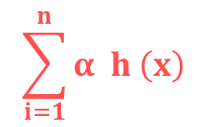
Computer Vision - Boosting
we can boost some part of the algorithm with the help of integral image approach
BUT there are way too many features
~ most of the features are irrelevant and not important at all
HOW TO SELECT THE BEST FEATURES? WITH BOOSTING !!!
we keep combining h(x)
weak learners (weak learner with
a single Haar-feature)
$$\sum_{i=1}^{n}{α h \left(x\right)}$$
H(x) = sign
i
i
final H(x) model which
is a strong classifier
every h(x) week learner
make a prediction
based on a single Haar-feature

Slide 156
Computer Vision - Boosting
At the beginning all the h(x) weak learners have the same weight
~ all of them contribute to the final decision (face is detected or not)
During the training phase Viola-Jones algorithm update
the weights for the h(x) weak learners (the features)
and finally we have the relevant features with higher weights

Slide 157

Computer Vision - Boosting
At the beginning all the h(x) weak learner have the same weight
~ all of them contribute to the final decision (face is detected or not)
During the training phase Viola-Jones algorithm update
the weights for the h(x) weak learners (the features)
and finally we have the relevant features with higher weights

Slide 158
Computer Vision - Boosting
At the beginning all the h(x) weak learner have the same weight
~ all of them contribute to the final decision (face is detected or not)
During the training phase Viola-Jones algorithm update
the weights for the h(x) weak learners (the features)
and finally we have the relevant features with higher weights

Slide 159
Computer Vision - Boosting
At the beginning all the h(x) weak learner have the same weight
~ all of them contribute to the final decision (face is detected or not)
During the training phase Viola-Jones algorithm update
the weights for the h(x) weak learners (the features)
and finally we have the relevant features with higher weights

Slide 160
Computer Vision - Boosting
At the beginning all the h(x) weak learner have the same weight
~ all of them contribute to the final decision (face is detected or not)
During the training phase Viola-Jones algorithm update
the weights for the h(x) weak learners (the features)
and finally we have the relevant features with higher weights

Slide 161
Cascading
With boosting we can make the algorithm quite fast ...
But can we do even better?
→ we know that most of the image region is non-face region
→ it is a better idea to have a simple method to check if a window
is not a face region: if it is not, discard it in a single shot
→ do not process unnecessary regions: focus on regions where
there can be a face instead
THIS IS WHY WE USE THE CASCADE CLASSIFIER CONCEPT
Instead of applying all the ~6000 Haar-features: we use the most relevant ones
in the first iteration (first stages contain very less features: 1, 10, 15, 50...)

Slide 162
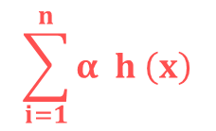
Cascading
How to find the most relevant features?
~ boosting algorithm has already found the best features
we keep combining h(x)
weak learners (weak learner with
a single Haar-feature)
$$\sum_{i=1}^{n}{α h \left(x\right)}$$
H(x) = sign
i
i
final H(x) model which
is a strong classifier
every h(x) week learner
make a prediction
based on a single Haar-feature
THE h(x) CLASSIFIERS WITH HIGHER α VALUES ARE THE RELEVANT FEATURES !!!
→ if the window does not contain the most relevant features we
can consider the next region on the image

Slide 163
Cascading
first feature
second feature
third feature
FACE
NOT A FACE
NOT A FACE
NOT A FACE

Slide 164
Optimal k Clusters (Hierarchical Clustering)
We can use the dendogram to find out the optimal value
of the k number of clusters
1.) determine the largest vertical distance that does
not intersect any of the other clusters
2.) draw a horizontal line at the top and at the bottom (at both extremities)
3.) count the number of vertical lines going through the horizontal line:
that is the optimal k number of clusters

Slide 165

Optimal k Clusters (Hierarchical Clustering)

